Slide 1
Quadratic Forms
Definition:
A homogeneous polynomial of the second degree in any number of variables is called a quadratic form.
Example:

Slide 2
Nature of Quadratic Form

Slide 3
The quadratic form is said to be
Positive definite if r = n, s = n.
Negative definite if r = n, s = 0.
Positive semi-definite if r < n, s = r.
Negative semi-definite if r < n, s = 0.
Indefinite in every other case.

Slide 4
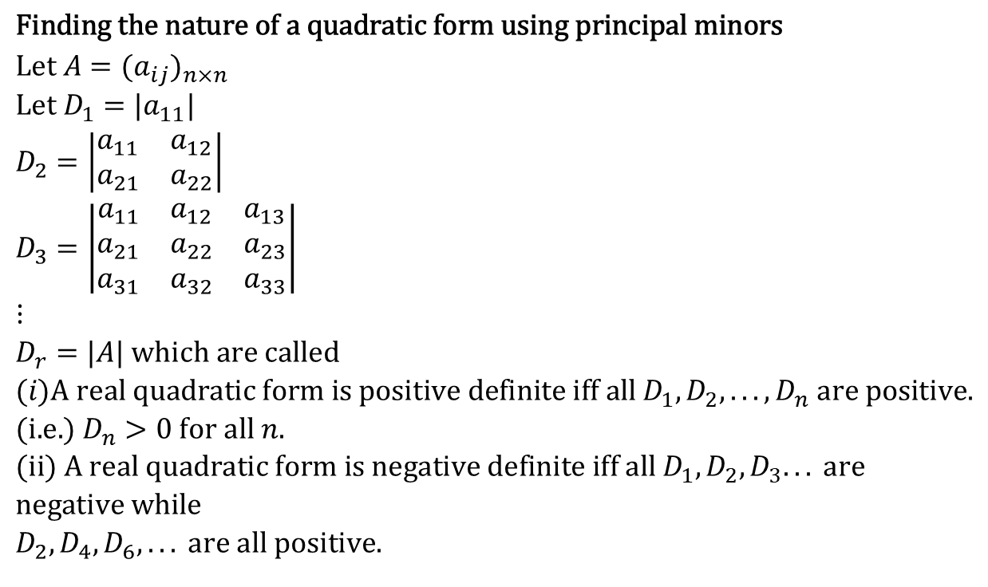
$$\text{Finding} \text{the} \text{nature} \text{of} \text{a} \text{quadratic} \text{form} \text{using} \text{principal} \text{minors} \\ \text{Let} A=(a_{ij})_{n×n} \\ \text{Let} D_{1}=|a_{11}| \\ D_{2}=\left|\begin{matrix}a_{11} & a_{12} \\ a_{21} & a_{22}\end{matrix}\right| \\ D_{3}=\left|\begin{matrix}a_{11} & a_{12} & a_{13} \\ a_{21} & a_{22} & a_{23} \\ a_{31} & a_{32} & a_{33}\end{matrix}\right| \\ ⋮ \\ D_{r}=|A| \text{which} \text{are} \text{called} \\ (i)\text{A} \text{real} \text{quadratic} \text{form} \text{is} \text{positive} \text{definite} \text{iff} \text{all} D_{1},D_{2},...,D_{n} \text{are} \text{positive}\text{.} \\ (\text{i}\text{.}\text{e}\text{.}) D_{n}>0 \text{for} \text{all} n. \\ (\text{ii}) \text{A} \text{real} \text{quadratic} \text{form} \text{is} \text{negative} \text{definite} \text{iff} \text{all} D_{1},D_{2},D_{3}... \text{are} \text{negative} \text{while} \\ D_{2},D_{4},D_{6},... \text{are} \text{all} \text{positive}\text{.}$$

Slide 5
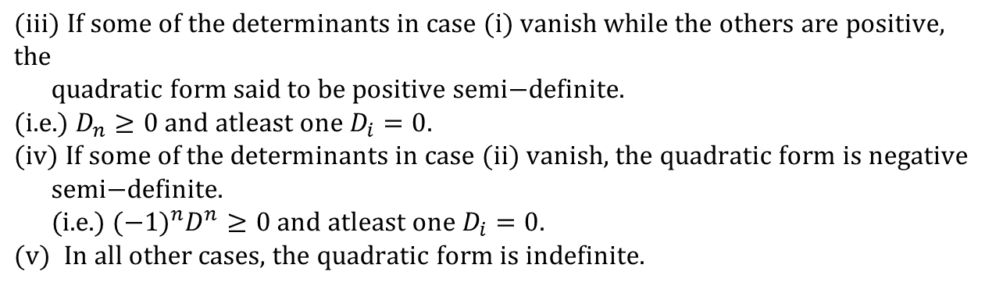
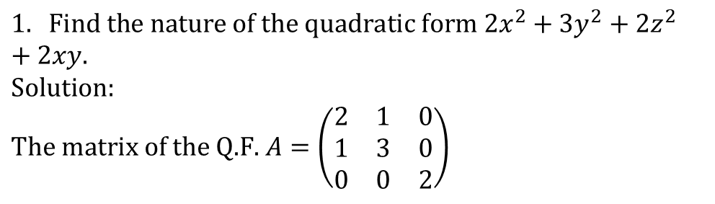
$$(\text{iii}) \text{If} \text{some} \text{of} \text{the} \text{determinants} \text{in} \text{case} (i) \text{vanish} \text{while} \text{the} \text{others} \text{are} \text{positive}\text{, }\text{the} \\ \text{quadratic} \text{form} \text{said} \text{to} \text{be} \text{positive} \text{semi}\text{−}\text{definite}\text{.} \\ (\text{i}\text{.}\text{e}\text{.}) D_{n}≥0 \text{and} \text{atleast} \text{one} D_{i}=0. \\ (\text{iv}) \text{If} \text{some} \text{of} \text{the} \text{determinants} \text{in} \text{case} (\text{ii}) \text{vanish}\text{, }\text{the} \text{quadratic} \text{form} \text{is} \text{negative} \\ \text{semi}\text{−}\text{definite}\text{.} \\ (\text{i}\text{.}\text{e}\text{.}) (−1)^{n}D^{n}≥0 \text{and} \text{atleast} \text{one} D_{i}=0. \\ (v) \text{In} \text{all} \text{other} \text{cases}\text{, }\text{the} \text{quadratic} \text{form} \text{is} \text{indefinite}\text{.}$$
Examples
$$1. \text{Find} \text{the} \text{nature} \text{of} \text{the} \text{quadratic} \text{form} 2x^{2}+3y^{2}+2z^{2}+2xy. \\ \text{Solution}\text{:} \\ \text{The} \text{matrix} \text{of} \text{the} \text{Q}\text{.}\text{F}\text{. }A=\left(\begin{matrix}2 & 1 & 0 \\ 1 & 3 & 0 \\ 0 & 0 & 2\end{matrix}\right)$$

Slide 6

$$D_{1}=|2|$$
$$D_{2}=\left|\begin{matrix}2 & 1 \\ 1 & 3\end{matrix}\right|=5>0$$
$$D_{3}=|A|=\left(\begin{matrix}2 & 1 & 0 \\ 1 & 3 & 0 \\ 0 & 0 & 2\end{matrix}\right)=2(6−1)=10>0$$
$$D_{1},D_{2},D_{3}>0$$
$$∴ \text{The} \text{quadratic} \text{form} \text{is} \text{positive} \text{definite}\text{.}$$
$$2. \text{Find} \text{the} \text{nature} \text{of} \text{the} \text{quadratic} \text{form} x_{1}^{2}+2x_{2}^{2}+3x_{3}^{2}+2x_{2}x_{1}−2x_{3}x_{1}+2x_{1}x_{2}. \\ \text{Solution}\text{:} \\ \text{The} \text{matrix} \text{of} \text{Q}\text{.}\text{F}\text{. }A=\left(\begin{matrix}1 & 1 & −1 \\ 1 & 2 & 1 \\ −1 & 1 & 3\end{matrix}\right)$$

Slide 7

$$D_{1}=\left|1\right|=1>0$$
$$D_{2}=\left|\begin{matrix}1 & 1 \\ 1 & 2\end{matrix}\right|=1>0$$
$$D_{3}=|A|=−2<0$$
$$D_{1},D_{2}>0,D_{3}<0$$
$$∴ \text{The} \text{quadratic} \text{form} \text{is} \text{indefinite}\text{.}$$

Slide 8
Nature of quadratic form:
1. If all the eigen values of the matrix are positive, then the given quadratic form is positive definite.
If all the eigen values of the matrix are negative then it is negative definite.
3. If atleast one eigen values of the matrix is zero and others are positive then it is positive semi definite.

Slide 9
4.If atleast one eigen value of the matrix is zero and others are negative then it is negative semi definite.
In all the other cases, the quadratic form is indefinite.
6. Number of positive square terms is called as index.

Slide 10
Examples
1) Reduce the quadratic form
8X₁² + 7X₂² + 3X₃² – 12X₁X₂ + 4X₁X₃ – X₂X₃
to a canonical form by an orthogonal transformation.
Solution
The matrix of given quadratic form is
8 -6 2
A= -6 7 -4
2 -4 3

Slide 11
8-λ -6 2
-6 7-λ -4 = 0
2 -4 3-λ
(8-λ)[(7-λ)(3-λ) – 16] + 6 [-6(3-λ) + 8] + 2[24-2(7-λ) = 0
λ³ - 18λ² + 45λ = 0
λ(λ² - 18λ + 45) = 0
λ =0, 3, 15
Therefore 0, 3, 15 are the eigen values.

Slide 12
To find the eigen vectors
(A - λI)X = 0
8- λ -6 2
-6 7- λ -4 X2 =0 … (1)
2 -4 3- λ X3
when λ = 0 in … (1)

Slide 13
8 -6 2 X₁ 0
-6 7 -4 X₂ = 0
2 -4 3 X₃ 0
8X₁ -6X₂ + 2X₃ = 0
-6X₁ + 7X₂ -4X₃ = 0
2X₁ – 4X₂ + 3X₃ = 0
By cross multiplication rule, Taking any two equations
The eigen vector corresponding to λ = 0 is
1
= 2
2

Slide 14

when λ = 3 in … (1)
5 -6 2 x₁ 0
-6 4 -4 x₂ = 0
2 -4 0 x₃ 0
5x₁ -6x₂ + 2x₃ = 0
-6x₁ + 4x₂ -4x₃ = 0
2x₁ – 4x₂ + 0x₃ = 0
By cross multiplication rule,
$\frac{x_{1}}{2}$ = $\frac{x_{2}}{1}$ = $\frac{x_{3}}{−2}$
The eigen vector corresponding to λ = 3 is
2
= 1
-2

Slide 15
When λ = 15 in … (1)
-7 -6 2 x₁ 0
-6 -8 -4 x₂ = 0
2 -4 -12 x₃ 0
-7x₁ -6x₂ + 2x₃ = 0
-6x₁ - 8x₂ – 4x₃ = 0
2x₁ – 4x₂ -12x₃ = 0
By cross multiplication rule, taking first two equations,
2
The eigen vector corresponding to λ = 15 is - 2
1

Slide 16
The normalised modal matrix is
1/√1²+2²+2² 2/ √ 2²+1²+(-2)² 2/ √2²+(-2)²+1²
N = 2/ √1²+2²+2² 1/ √1²+2²+(-2)² -2/ √1²+(-2)²+2²
2/ √1²+2²+2² -2/ √1²+2²+(-2)² 1/ √1²+2²+(-2)²
1/3 2/3 2/3
= 2/3 1/3 -2/3
2/3 -2/3 1/3
N^{T} 1/3 2/3 2/3
= 2/3 1/3 -2/3
2/3 -2/3 1/3

Slide 17

Let X = NY be the orthogonal transformation then
=
Canonical form of the matrix = $\left(y_{1 }y_{2 }y_{3}\right)$ $N^{T}A N$ $\left(\begin{matrix}y_{1 } \\ y_{2 } \\ y_{3}\end{matrix}\right)$
$${Q=X^{T}AX=Y}^{T }N^{T}A N Y$$
2/3 1/3 -2/3
N
2/3 1/3 -2/3
2/3 -2/3 1/3

Slide 18
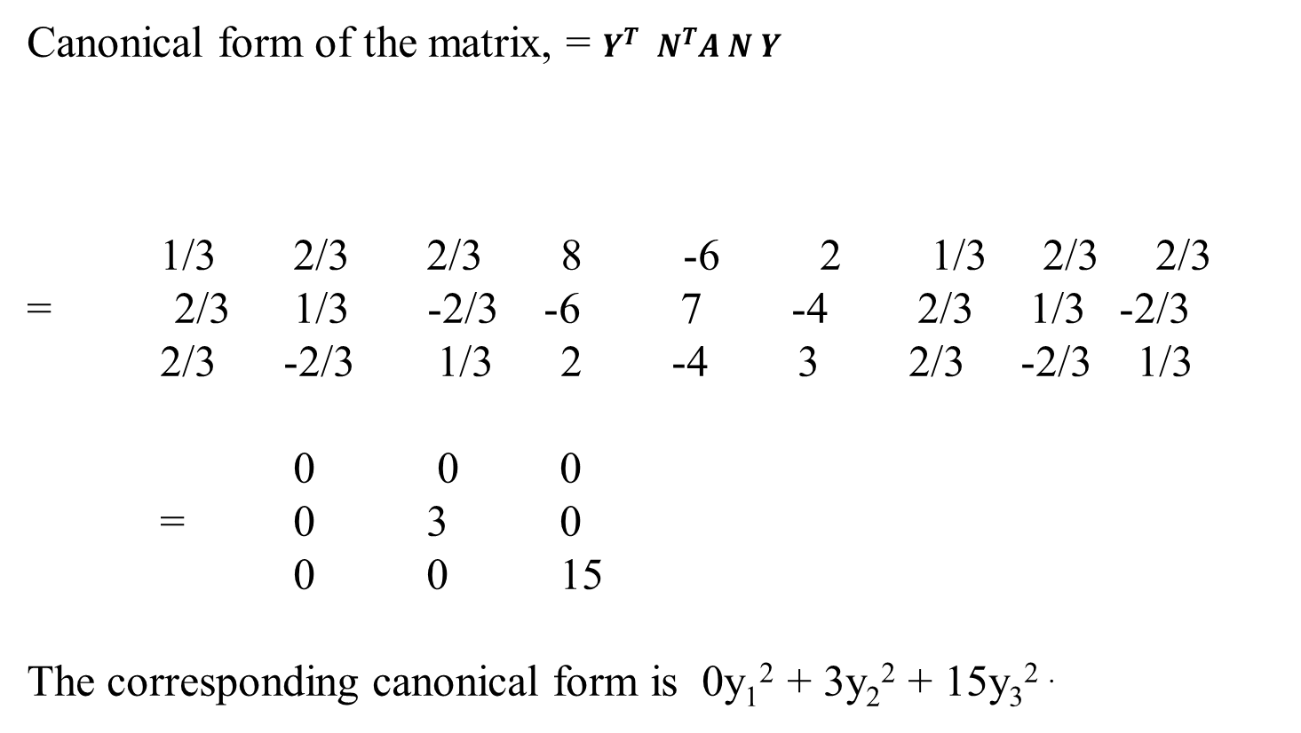
Canonical form of the matrix, = $Y^{T }N^{T}A N Y$
1/3 2/3 2/3 8 -6 2 1/3 2/3 2/3
= 2/3 1/3 -2/3 -6 7 -4 2/3 1/3 -2/3
2/3 -2/3 1/3 2 -4 3 2/3 -2/3 1/3
0 0 0
= 0 3 0
0 0 15
The corresponding canonical form is 0y₁² + 3y₂² + 15y₃^{2 .}

Slide 19
2) Reduce the quadratic form
6X₁² + 3X₂² + 3X₃² – 4X₁X₂ + 4X₁X₃ – 2X₂X₃
to a canonical form by an orthogonal transformation.Also find the rank,index ,signature and nature of the quadratic form.
Solution
The matrix of given quadratic form is
6 -2 2
A= -2 3 -1
2 -1 3

Slide 20
Characteristic eqn is |A-λI| = 0
6-λ -2 2
-2 3-λ -1 = 0
2 -1 3-λ
λ³ - 12λ² + 36λ – 36 = 0
Solving this, we get
λ =2, 2, 8
Therefore 2, 2, 8 are the eigen values.

Slide 21
To find the eigen vectors
(A - λI)X = 0
6- λ -2 2 X1
-2 3- λ -1 X2 =0 … (1)
2 -1 3- λ X3
when λ = 8 ,
Equation (1) becomes,

Slide 22

-2 -2 2 x₁ 0
-2 -5 -1 x₂ = 0
2 -1 -5 x₃ 0
-2x₁ -2x₂ + 2x₃ = 0
-2x₁ -5x₂ -1x₃ = 0
By cross multiplication rule,
$\frac{x_{1}}{2}$ = $\frac{x_{2}}{−1}$ = $\frac{x_{3}}{1}$
The eigen vector corresponding to λ = 8 is
2
= -1
1

Slide 23
Put λ = 2 in … (1)
4 -2 2 x₁ 0
-2 1 -1 x₂ = 0
2 -1 1 x₃ 0
4x₁ -2x₂ -2x₃ = 0
-2x₁ + x₂ -1x₃ = 0
2x₁ – 1x₂ + x₃ = 0
Let x₁ = 0
x₂ =1 , x₃ =1
The eigen vector corresponding to λ = 2 is
0
= 1
1

Slide 24
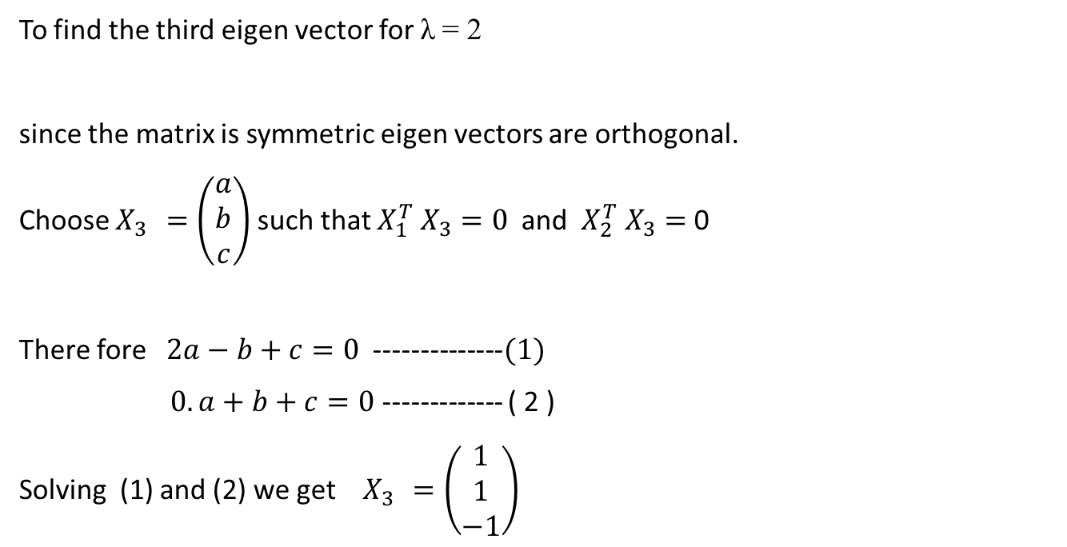
To find the third eigen vector for λ = 2
since the matrix is symmetric eigen vectors are orthogonal.
Choose $X_{3 }=\left(\begin{matrix}a \\ b \\ c\end{matrix}\right)$ such that $X_{1}^{T} X_{3}=0$ and $X_{2}^{T} X_{3}=$0
There fore $2a−b+c=0$ --------------$(1)$
$0.a+b+c=0$ ------------- ( 2 )
Solving (1) and (2) we get $X_{3 }=\left(\begin{matrix}1 \\ 1 \\ −1\end{matrix}\right)$

Slide 25

The normalised modal matrix is
2/√6 0 1/ √3
N= -1/ √6 1/ √2 1/ √3
1/√6 1/ √2 -1/ √3
Canonical form of the matrix = $Y^{T }N^{T}A N Y$
2/√6 -1/√6 1/√6 6 -2 2 2/√6 0 1/√3
= 0 1/√2 1/ √2 -2 3 -1 1/√6 1/√2 1/√3
1/√3 1/√3 -1/√3 2 -1 3 1/√6 1/√2 -1/√3

Slide 26
8 0 0
= 0 2 0
0 0 2
The canonical form is 8y₁² + 2y₂² + 2y₃^{2 .}
All the eigen values are positive, the given quadratic form is positive
definite. Index =3,rank of A =3,Signature =3.

Slide 27
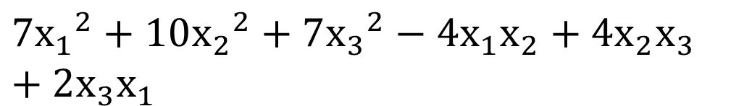
Problems for practice:
Reduce the quadratic form into a canonical form for the following matrices ,find the rank, index ,nature and signature of the Q.F
(i)
$$7{x_{1}}^{2}+10{x_{2}}^{2}+7{x_{3}}^{2}−4x_{1}x_{2}+4x_{2}x_{3}+2x_{3}x_{1}$$
(ii)

